Slide 1

Front End Engineering-II
Project Presentation
Semester-III (Batch-2023)
CRYPTO WATCH
Supervised By : Submitted By:
Dr. Vijaita Kashyap Muskaan Aggarwal, 2310990661 Naman Nayak, 2310990746
Kartik Sharma, 2310992032 Kritika Sawhney, 2310992046
Department of Computer Science and Engineering
Chitkara University Institute of Engineering & Technology,
Chitkara University, Punjab
1

Slide 2
Abstract
The Crypto Watch project is a web application designed to assist cryptocurrency investors and traders by addressing the limitations of existing tracking and analysis tools. It provides real-time price updates, historical data, and in-depth analytical features for multiple cryptocurrencies. Additionally, it includes a dedicated news page for the latest cryptocurrency developments, a comprehensive learning section for users at all skill levels, and a cryptocurrency converter for seamless exchange between various digital assets.
The platform features a responsive design for a consistent user experience across desktop, tablet, and mobile devices. Users can create watchlists, view historical charts, and conduct technical analysis. The newsletter and feedback sections ensure users stay informed and can contribute to the continuous improvement of the platform. With Crypto Watch, the aim is to offer a unified, reliable solution to support decision-making and strategy development in the volatile cryptocurrency market.
2

Slide 3
Table of contents
Introduction
Problem definition and requirements
Modules
Results
Conclusion
3

Slide 4
Introduction
Background:
The rise of cryptocurrencies has revolutionized the financial landscape, introducing decentralized digital currencies like Bitcoin, Ethereum, and many others. As the cryptocurrency market expands, it has attracted a wide range of participants, including institutional investors, retail traders, and beginners looking to explore alternative assets. However, the market's extreme volatility and the decentralized nature of cryptocurrencies present significant challenges for investors and traders. These challenges include navigating fragmented information sources, analyzing real-time data efficiently, and making informed decisions in a rapidly changing market.
Existing tools and platforms that provide cryptocurrency data are often limited in scope, lack real-time updates, or fail to offer comprehensive analysis options. Users are forced to rely on multiple sources to track price changes, access historical data, and stay informed about the latest market news. This creates inefficiencies and adds complexity to the decision-making process.
To address these issues, Crypto Watch was conceived as a comprehensive solution. It integrates real-time price updates, customizable watchlists, advanced charting tools, and market news into a single, user-friendly platform. By consolidating these essential tools, Crypto Watch aims to streamline the cryptocurrency trading experience and provide both experienced traders and newcomers with the resources needed to make informed decisions in this fast-paced market.
4

Slide 5
Objectives:
Provide real-time price tracking for a wide range of cryptocurrencies.
Offer comprehensive historical data and analysis tools to support informed decision-making.
Develop a user-friendly platform with customizable watchlists and advanced charting features.
Integrate a news page to keep users updated on the latest cryptocurrency developments.
Create a learning section to educate both beginners and advanced users about the cryptocurrency market.
Implement a cryptocurrency converter for seamless exchange between digital currencies.
Ensure the platform is accessible across devices through responsive design (desktop, tablet, and mobile).
Facilitate user engagement with newsletter subscriptions and feedback mechanisms for continuous platform
improvement.
Enhance security and reliability by sourcing data from trusted and accurate sources.
5

Slide 6
Significance:
Streamlined Decision-Making: Crypto Watch consolidates multiple essential tools—such as real-time price tracking, historical data, and market news—into one platform, eliminating the need for users to rely on multiple fragmented sources. This streamlining improves efficiency for investors and traders.
Improved Accessibility: By offering a responsive design, Crypto Watch ensures that users can access critical market data anytime and anywhere, whether they’re on a desktop, tablet, or mobile device. This accessibility is crucial in the fast-paced cryptocurrency market where decisions often need to be made on the go.
Comprehensive Market Analysis: By integrating reliable, real-time data and tools for technical analysis, Crypto Watch empowers users to develop informed trading strategies, potentially leading to better investment outcomes in a volatile market.
Ongoing Engagement and Evolution: With feedback and newsletter features, users are not only kept informed about market updates but are also encouraged to contribute their suggestions, allowing the platform to continuously evolve to meet changing market demands.
6

Slide 7
Problem statement
The cryptocurrency market is characterized by extreme volatility, a rapidly changing landscape, and fragmented information sources. Investors and traders face significant challenges in making informed decisions due to the lack of a unified platform that offers real-time price tracking, historical data, technical analysis tools, and up-to-date market news. Existing solutions are often disjointed, forcing users to rely on multiple platforms, which can be inefficient and lead to missed opportunities or poor decision-making. Furthermore, newcomers to the cryptocurrency space struggle to find reliable, comprehensive educational resources that cover both basic and advanced topics.
This project aims to address these issues by developing Crypto Watch, an all-in-one platform that integrates real-time data, market analysis tools, educational resources, and a user-friendly interface, helping both experienced traders and beginners navigate the complexities of the cryptocurrency market more effectively.
7

Slide 8
Modules
1. Unified Data Integration:
Consolidates real-time price updates from multiple reliable sources.
Reduces confusion by providing accurate and consistent market data in one interface.
2. Advanced Analytical Tools:
Provides detailed historical data in the form of charts. (daily, weekly, monthly).
Includes sophisticated charting tools.
3. Cross-Device Compatibility:
Ensures a seamless experience on desktops, tablets, and mobile devices.
Provides consistent access to trading and monitoring features across all devices.
4. Comprehensive User Forms:
Integrates feedback, sign-up, and sign-in forms to enhance user engagement.
Users can seamlessly provide feedback, register for an account, and sign in to access their personalized crypto tracking features with ease and security.
8

Slide 9
Modules
5. Educational Resources:
Offers tutorials, articles, and videos to assist users in understanding cryptocurrency trading.
Aims to improve user competence with practical and theoretical knowledge.
6. Customizable Analysis Setup:
Allows users to create tailored analytical setups based on their trading strategies.
Supports multiple analytical methods for more effective market evaluation.
7. Real-Time Market Alerts:
Provides automatic alerts for critical market changes and trading signals.
Helps users respond promptly to price fluctuations and market events.
8. Streamlined Trading Experience:
Integrates all necessary trading tools and data into a single platform.
Enhances overall trading efficiency and user experience by reducing the need for multiple applications.
.

Slide 10
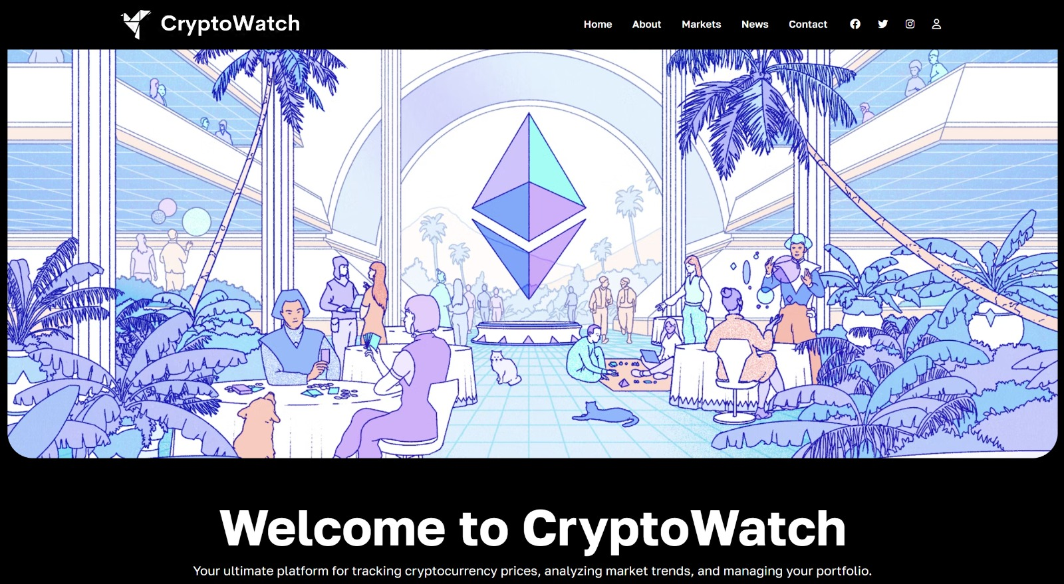
Landing
10

Slide 11
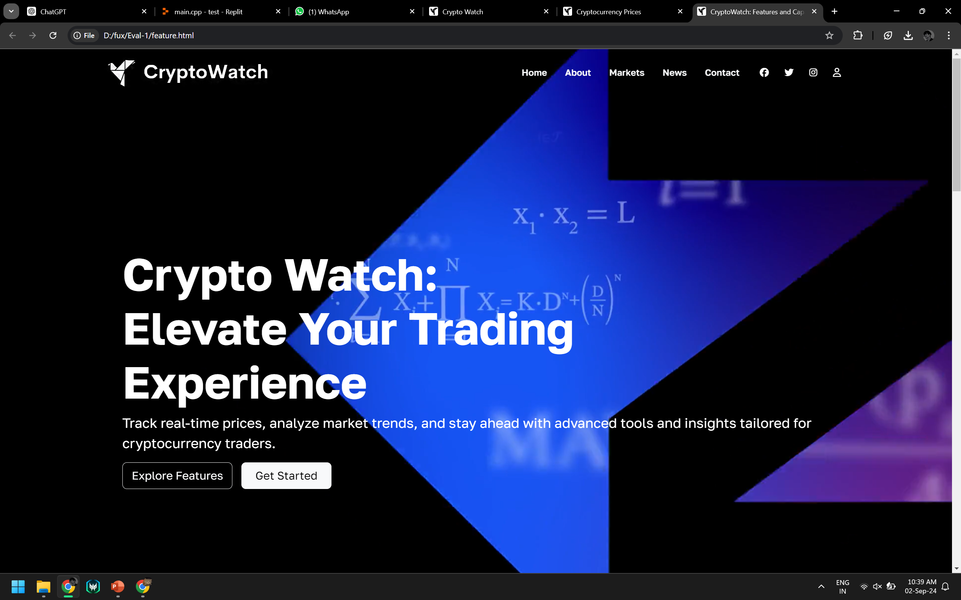
Features
11

Slide 12
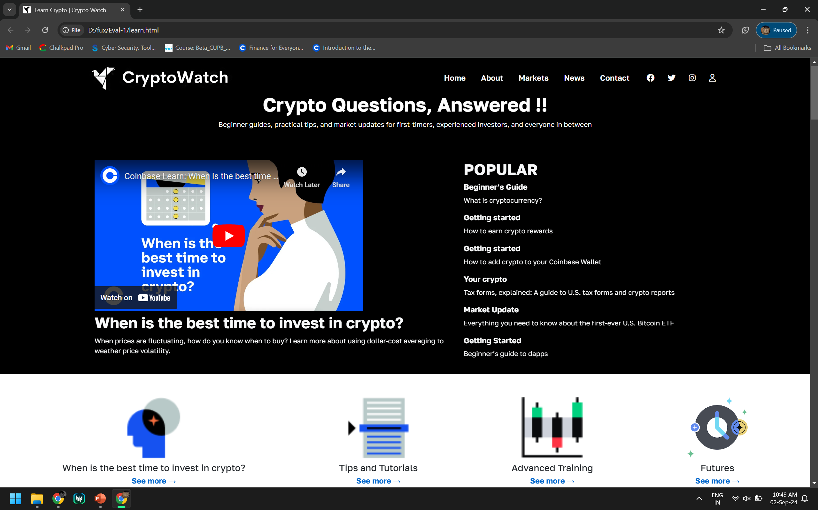
FAQ
12

Slide 13
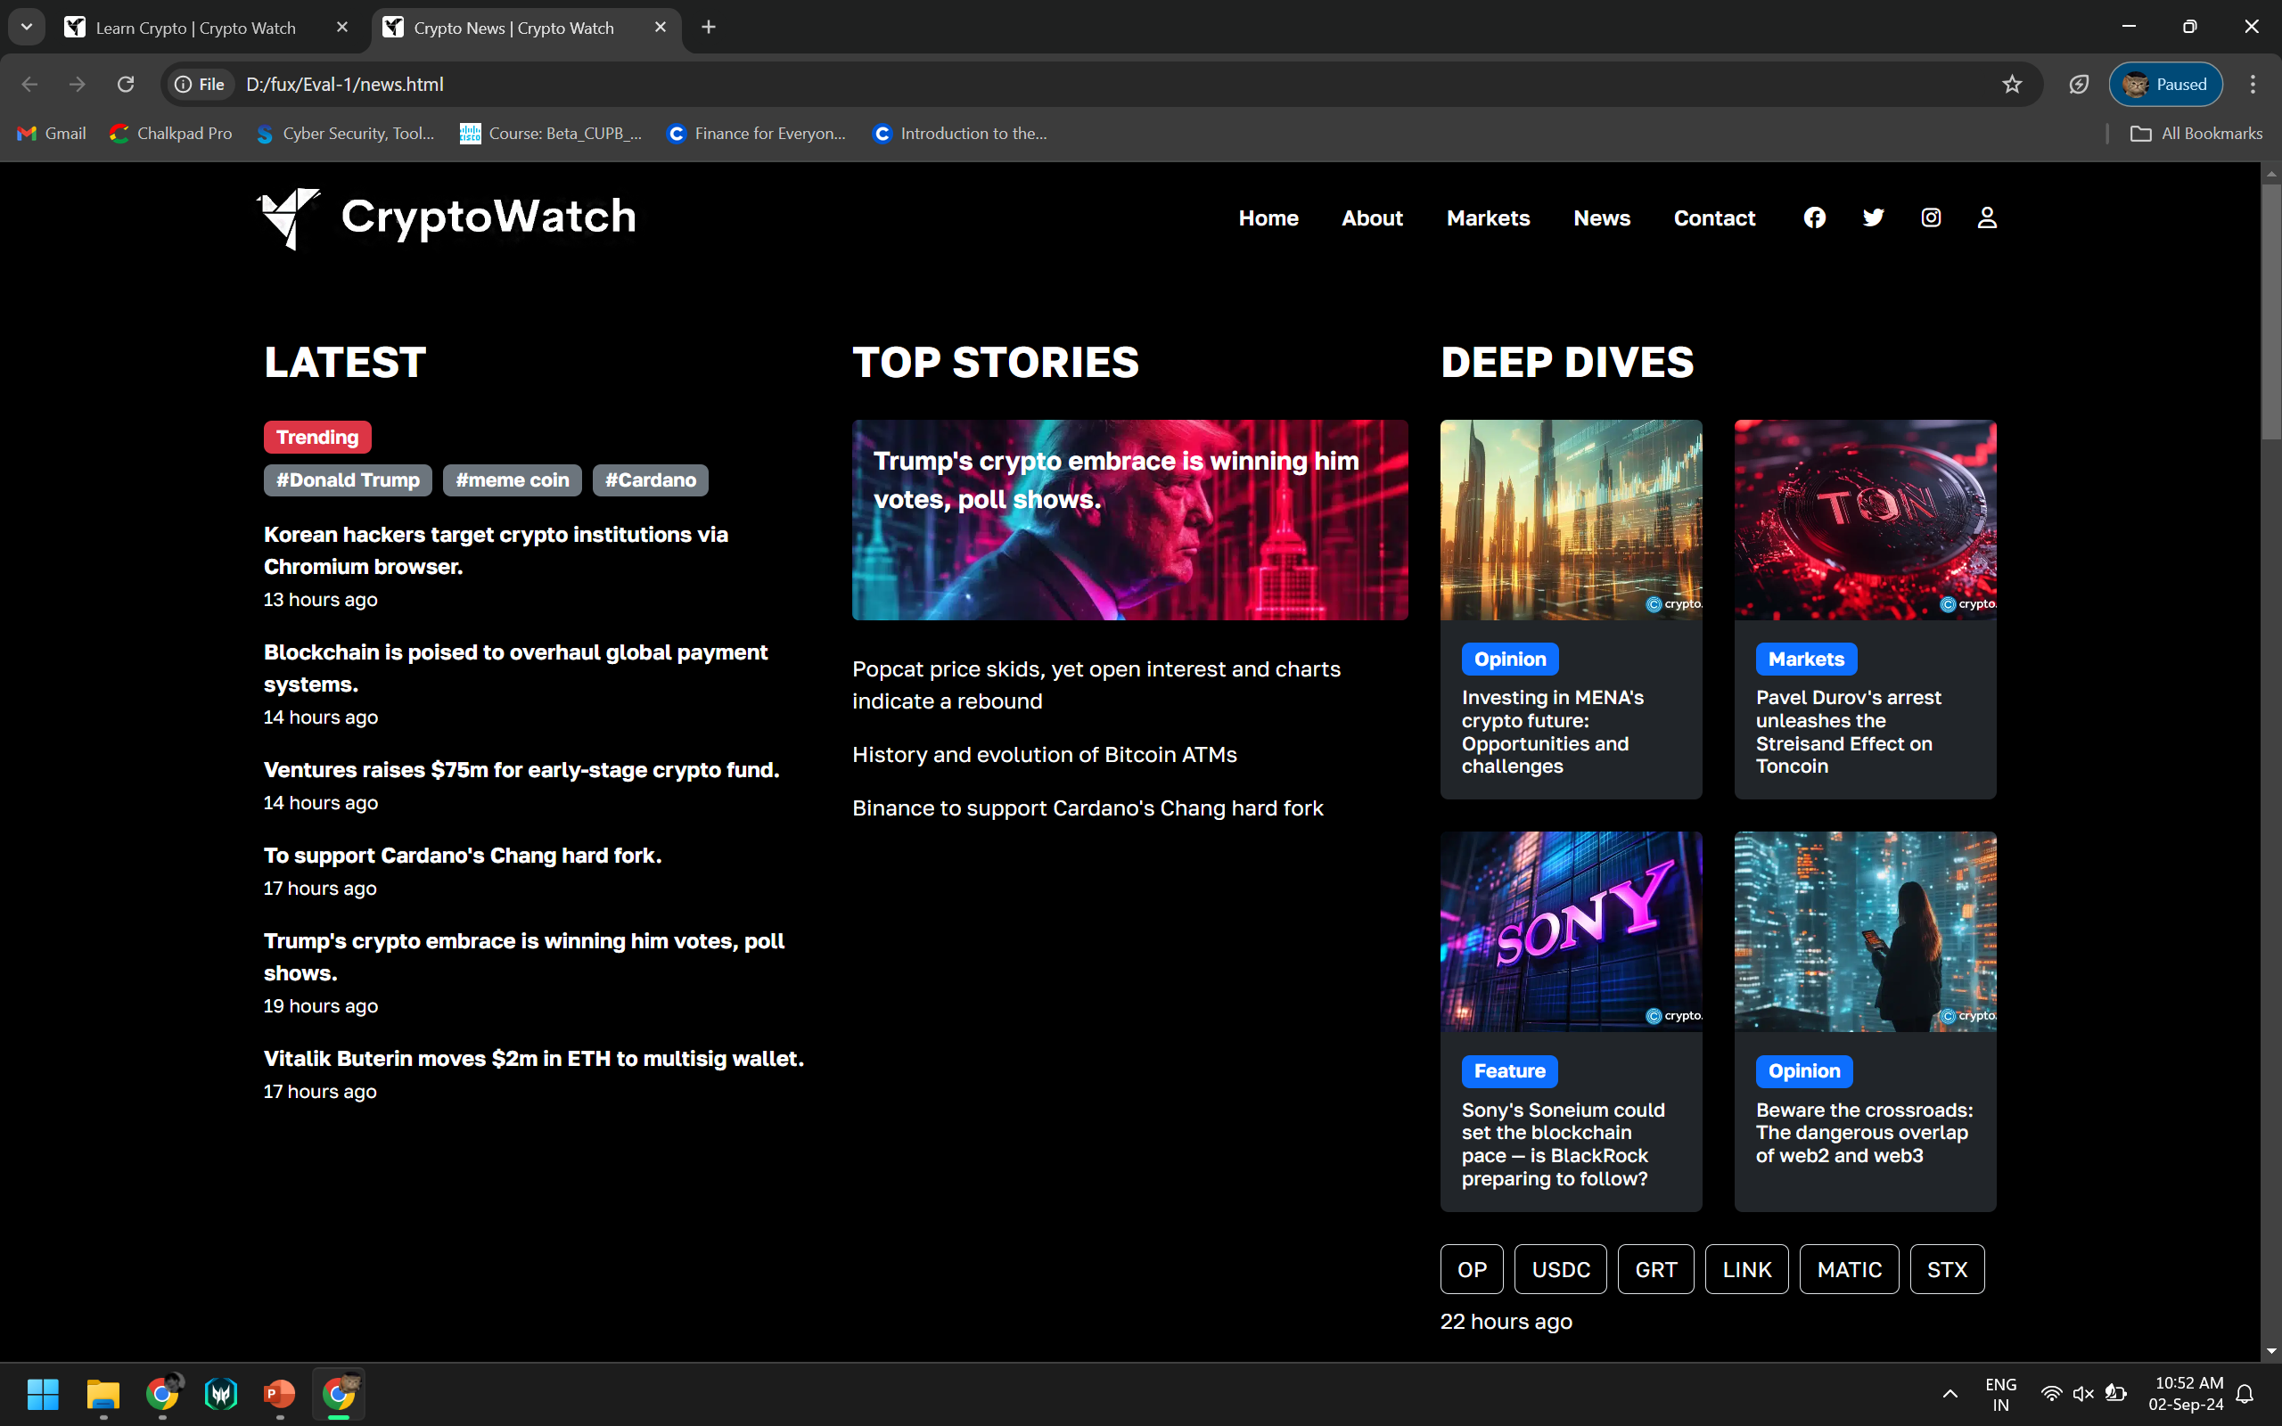
News
13

Slide 14
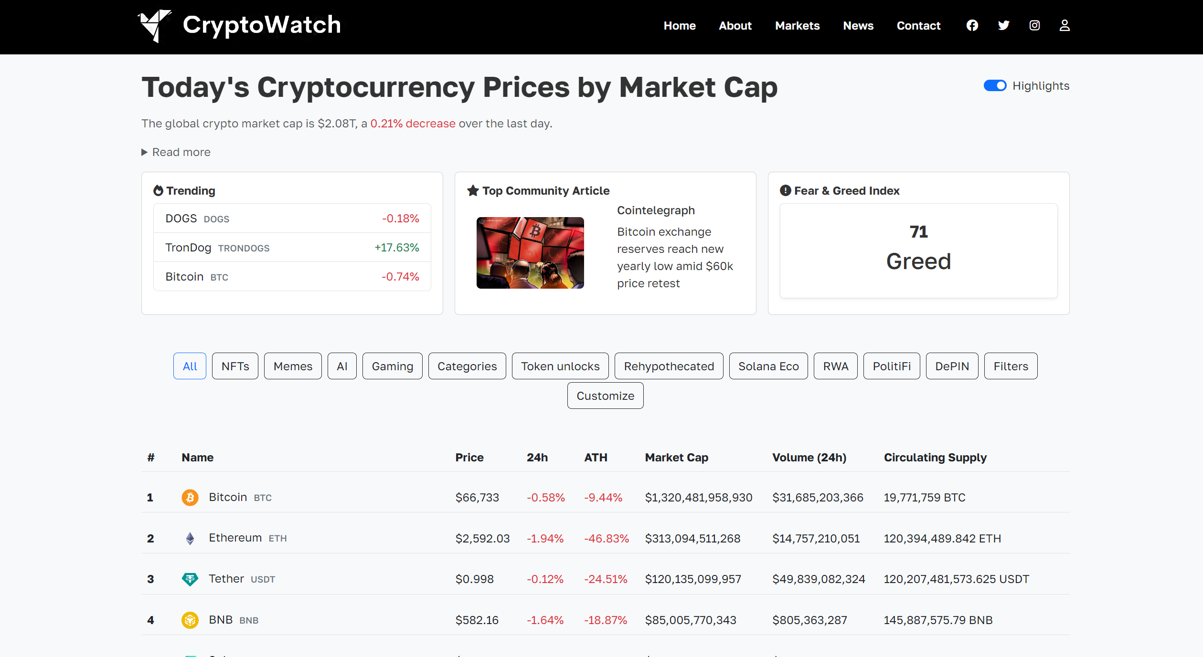
Markets
14

Slide 15
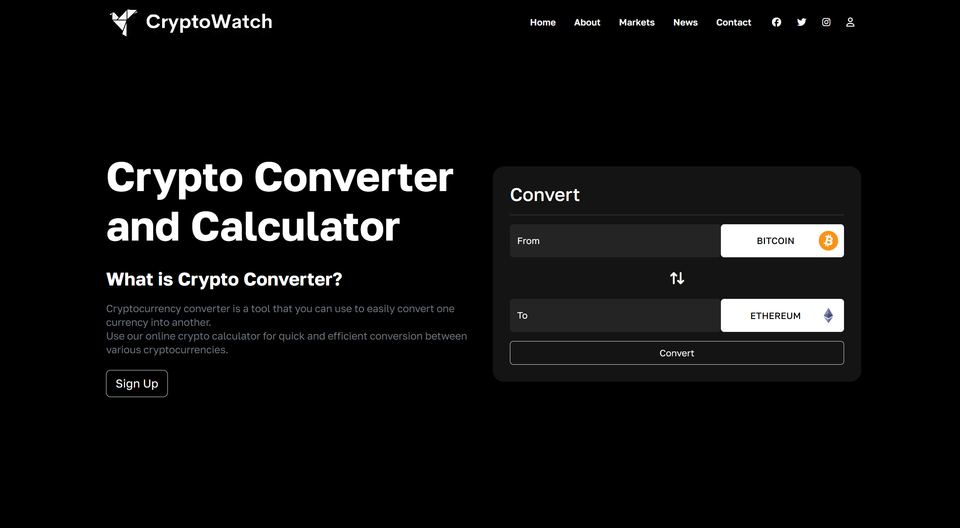
Converter
15

Slide 16
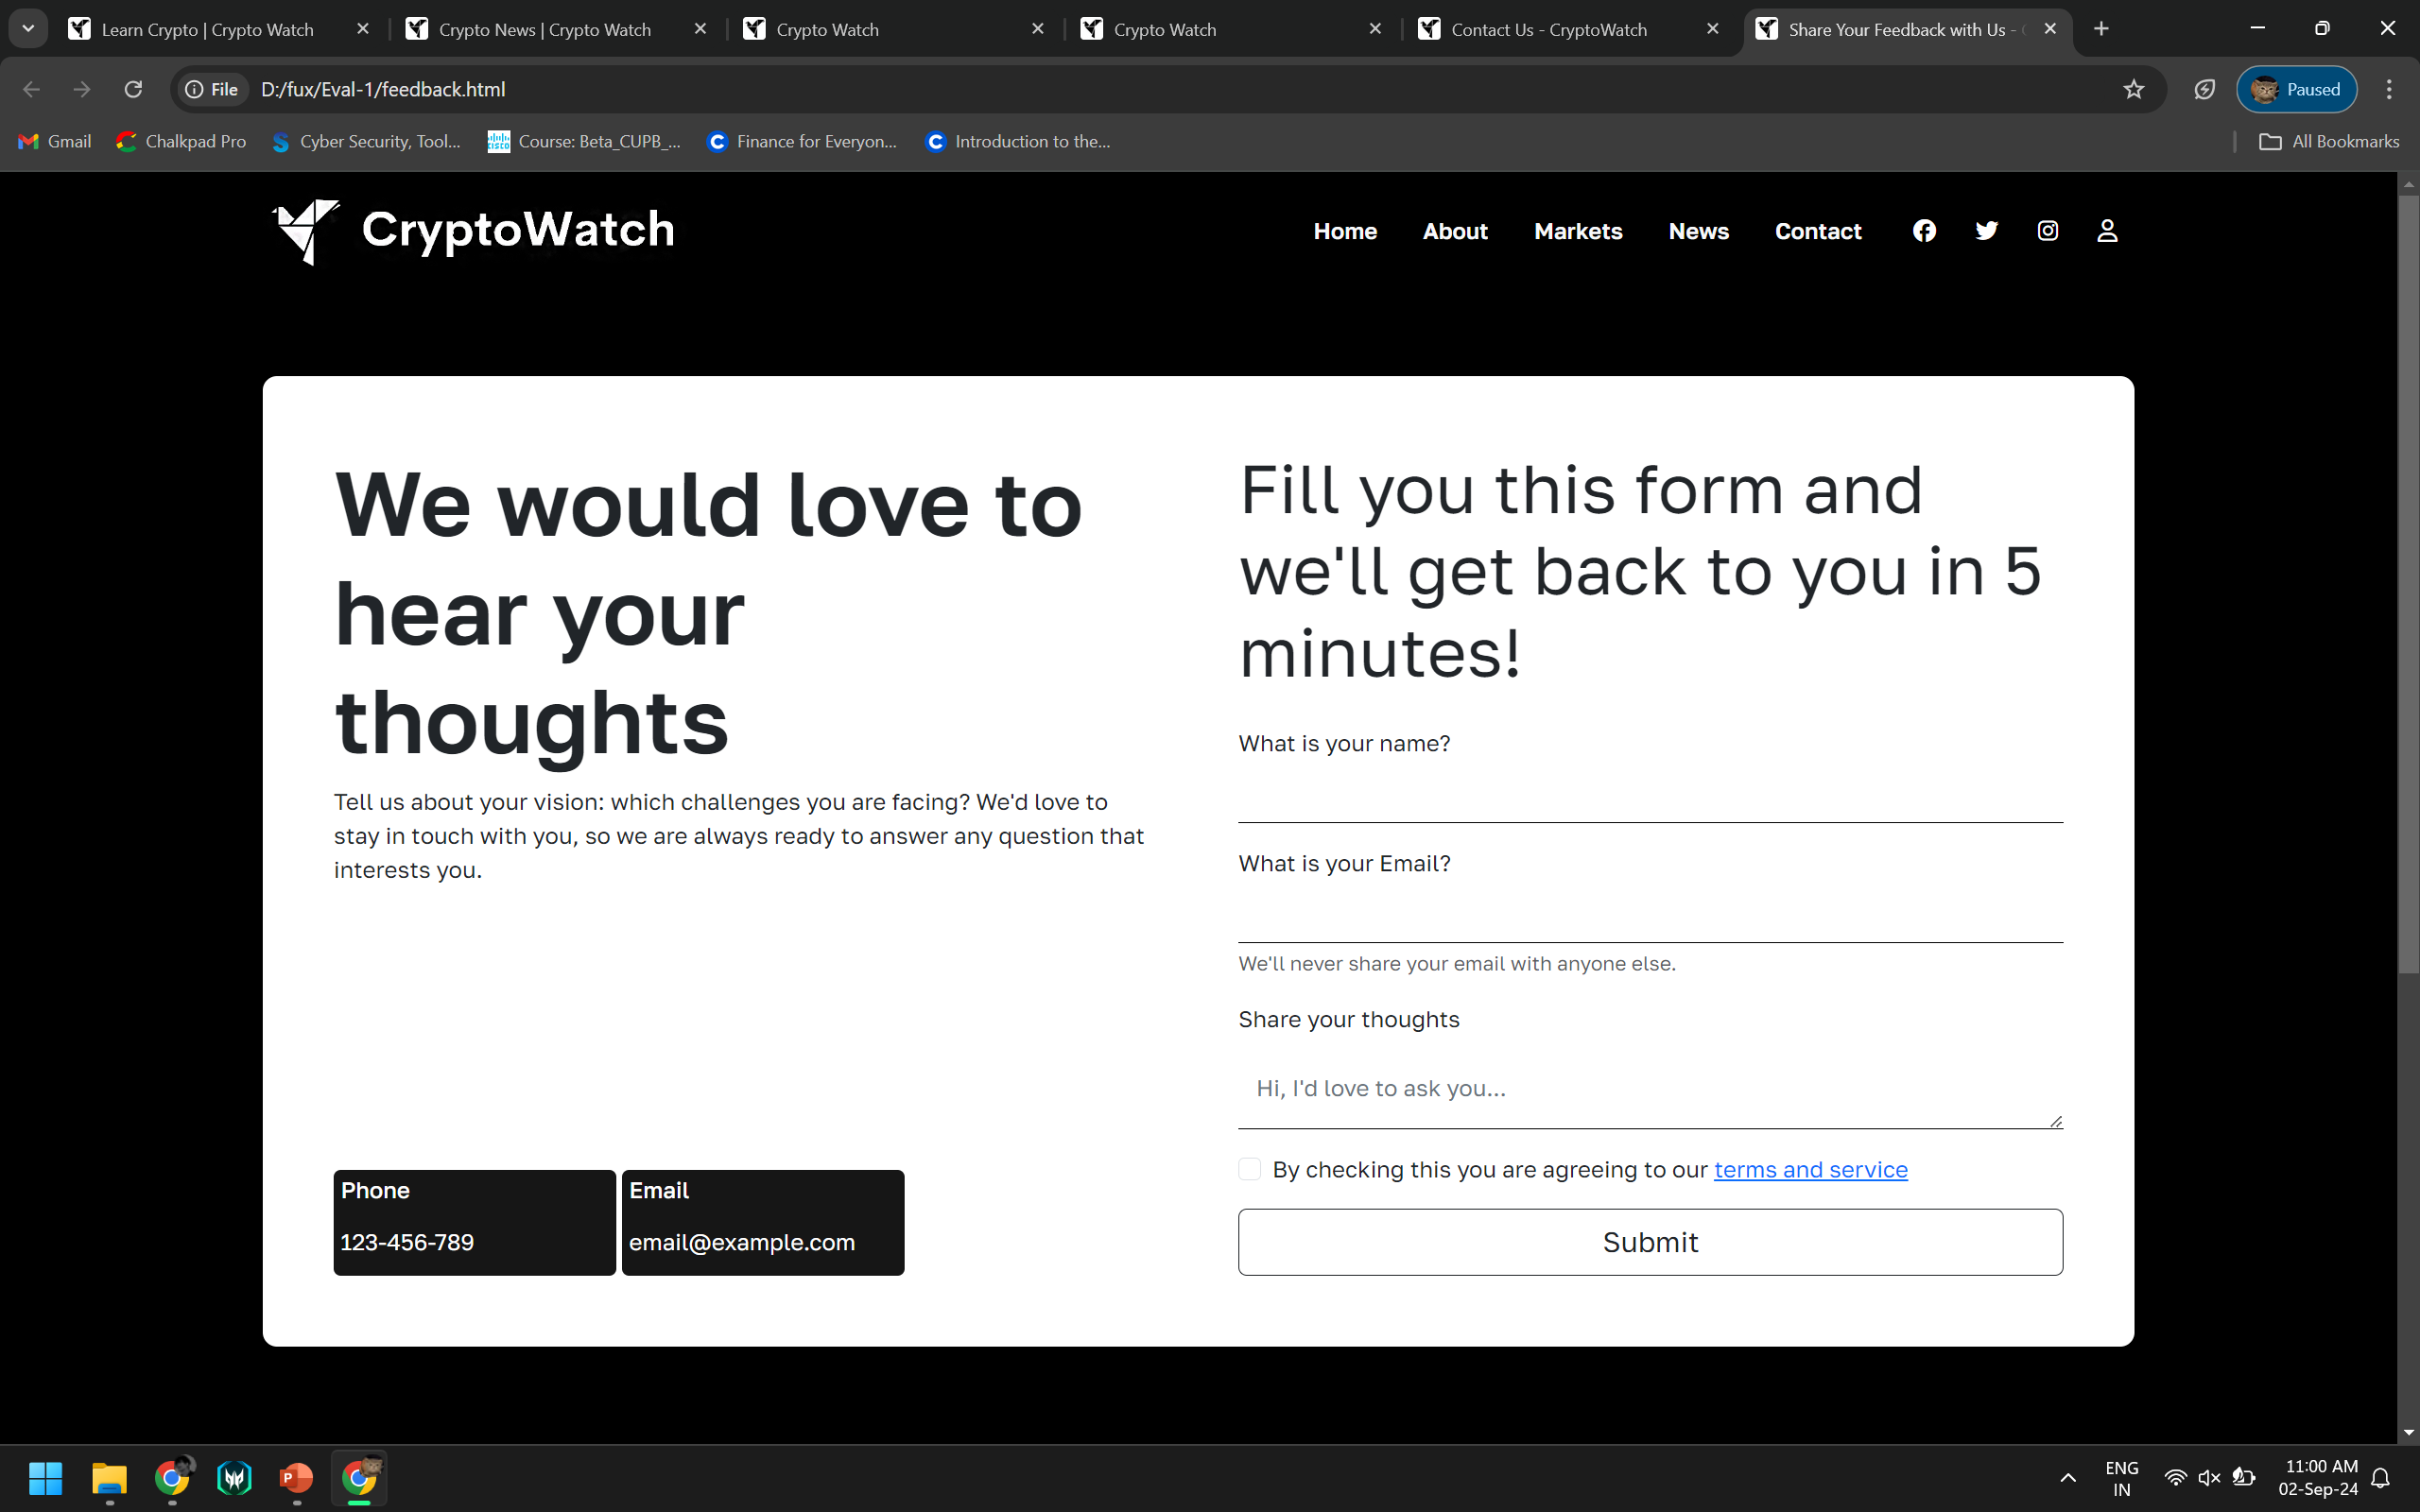
Feedback
16

Slide 17
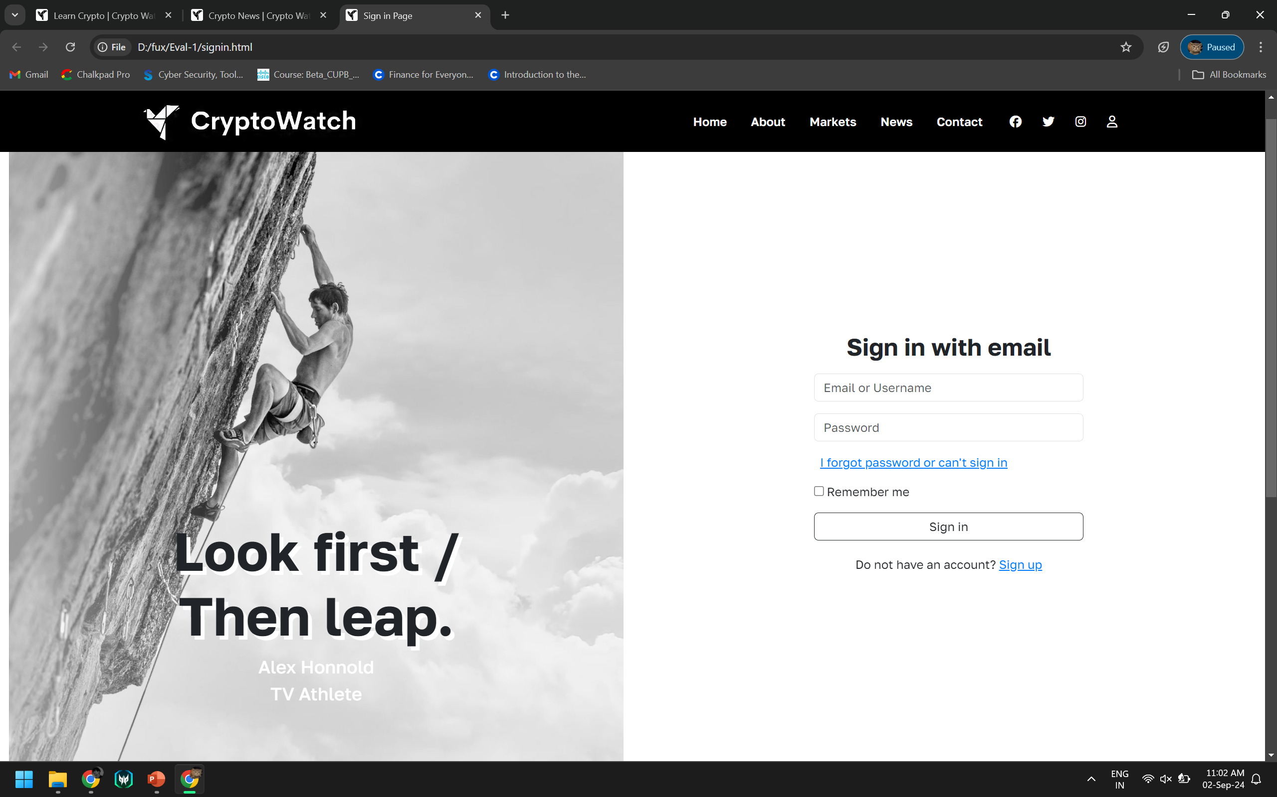
Sign in
17

Slide 18
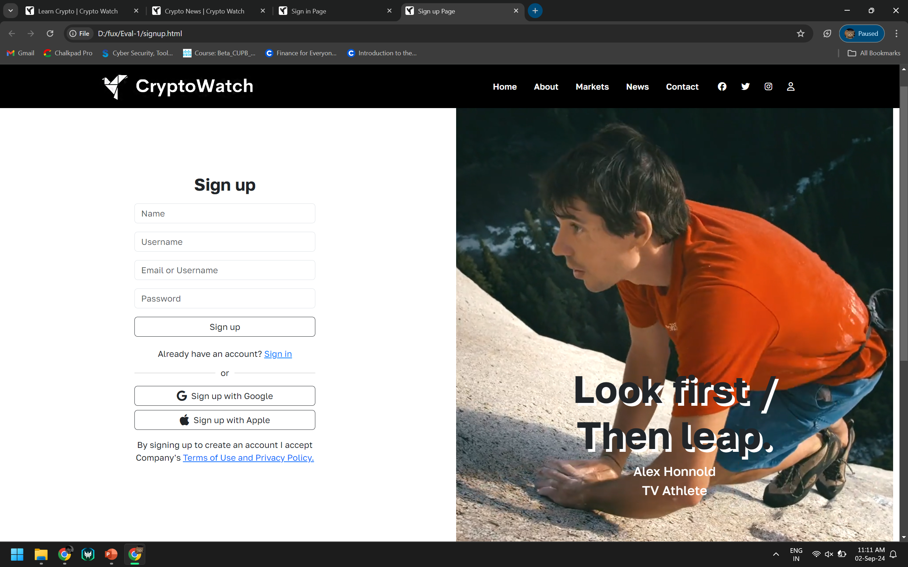
Sign up
18

Slide 19
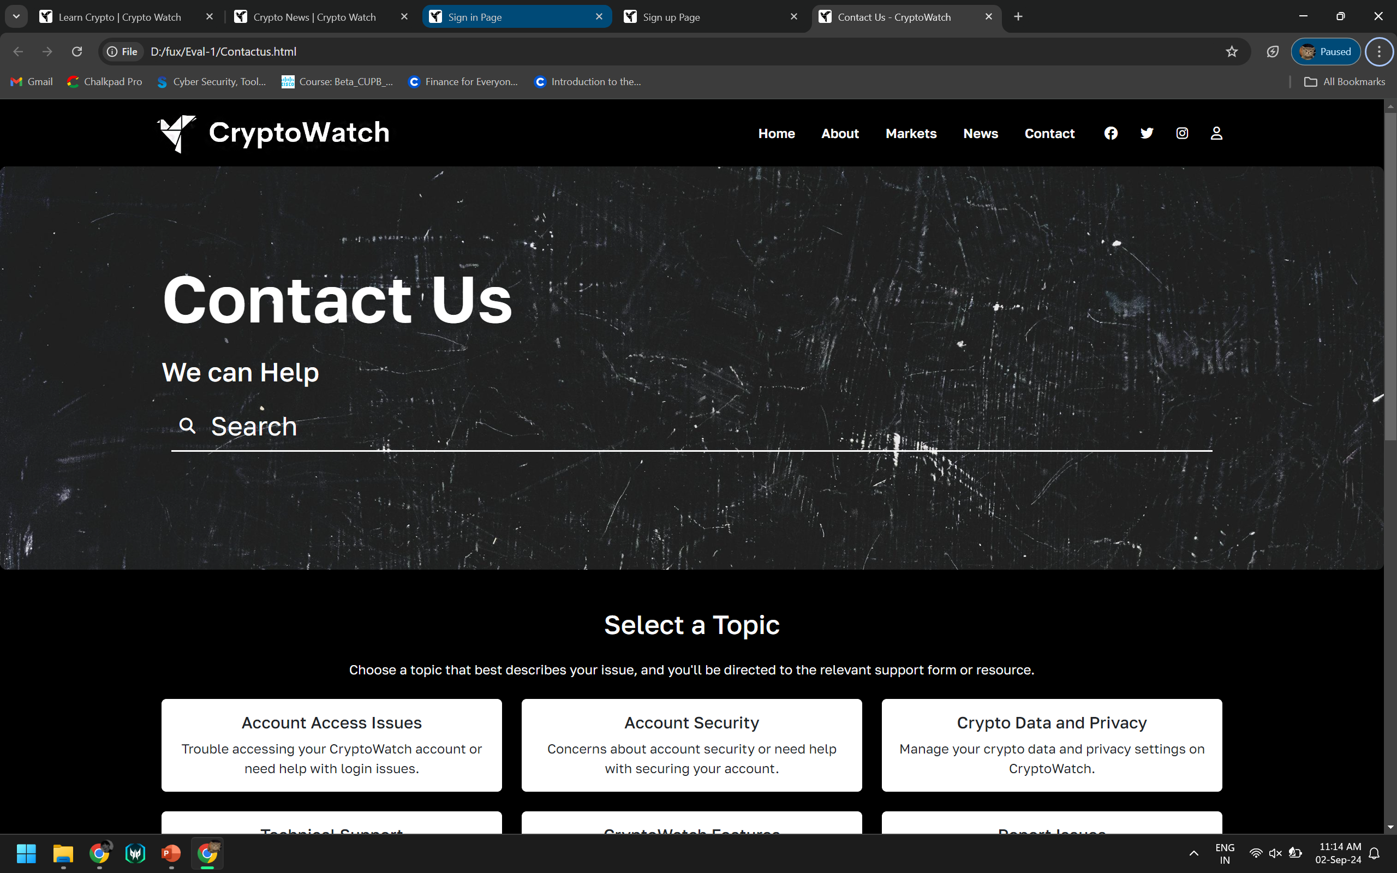
Contact
19

Slide 20
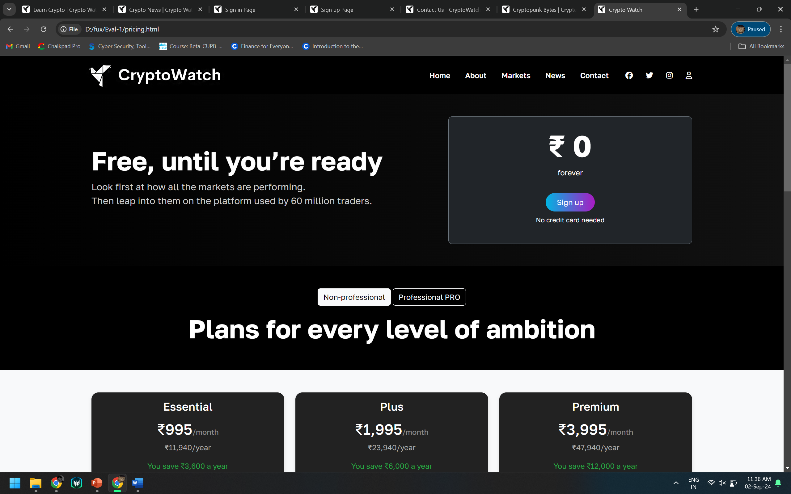
Pricing
20

Slide 21
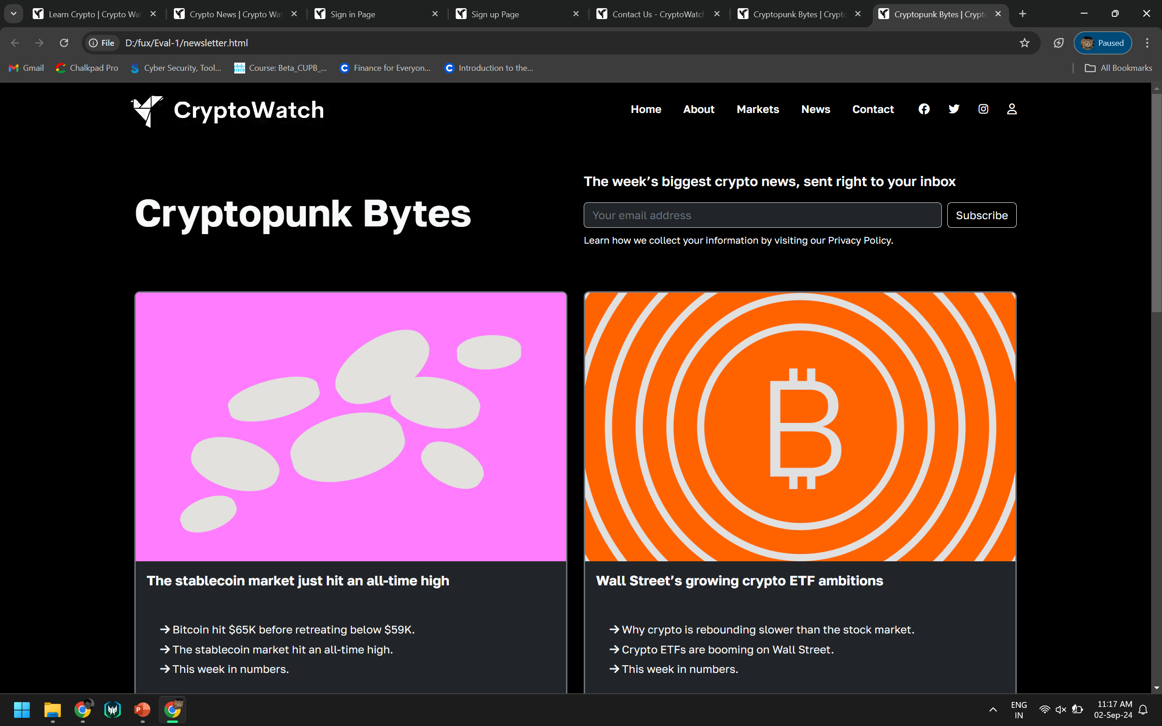
Newsletter
21

Slide 22
Conclusion
Comprehensive Trading Platform: The platform offers real-time data, advanced analysis, and customizable alerts to streamline cryptocurrency trading.
User-Friendly Design: It provides an intuitive interface accessible on all devices, making cryptocurrency management simple and efficient.
Enhanced Security: Strong encryption and secure authentication are employed to safeguard user data and privacy.
Educational Support: The platform includes tutorials and resources to help users improve their understanding of cryptocurrency trading.
Future-Ready: Built with modern technologies, it is designed to adapt to changing market trends and evolving user needs.
OUR TEAM’S TAKEWAY
To understand the concepts of HTML, CSS, Bootstrap , JavaScript and React.
To put our knowledge into practice and create something revolutionary.
FUTURE SCOPE
Looking ahead, we are aiming to implement backend in the future to make the website more professional and dynamic. This will allow us to enhance the user interface, making it more interactive and responsive across devices. Additionally, these technologies will enable faster load times and smoother real-time data updates, further improving the overall user experience and scalability of the platform.
22

Slide 23
Thank You
23

